Slide 1
Skyline Batch Transition
1) High level code overview
2) Running tests
3) Where to find files
4) Releasing Skyline Batch
5) Starting new features

Slide 2
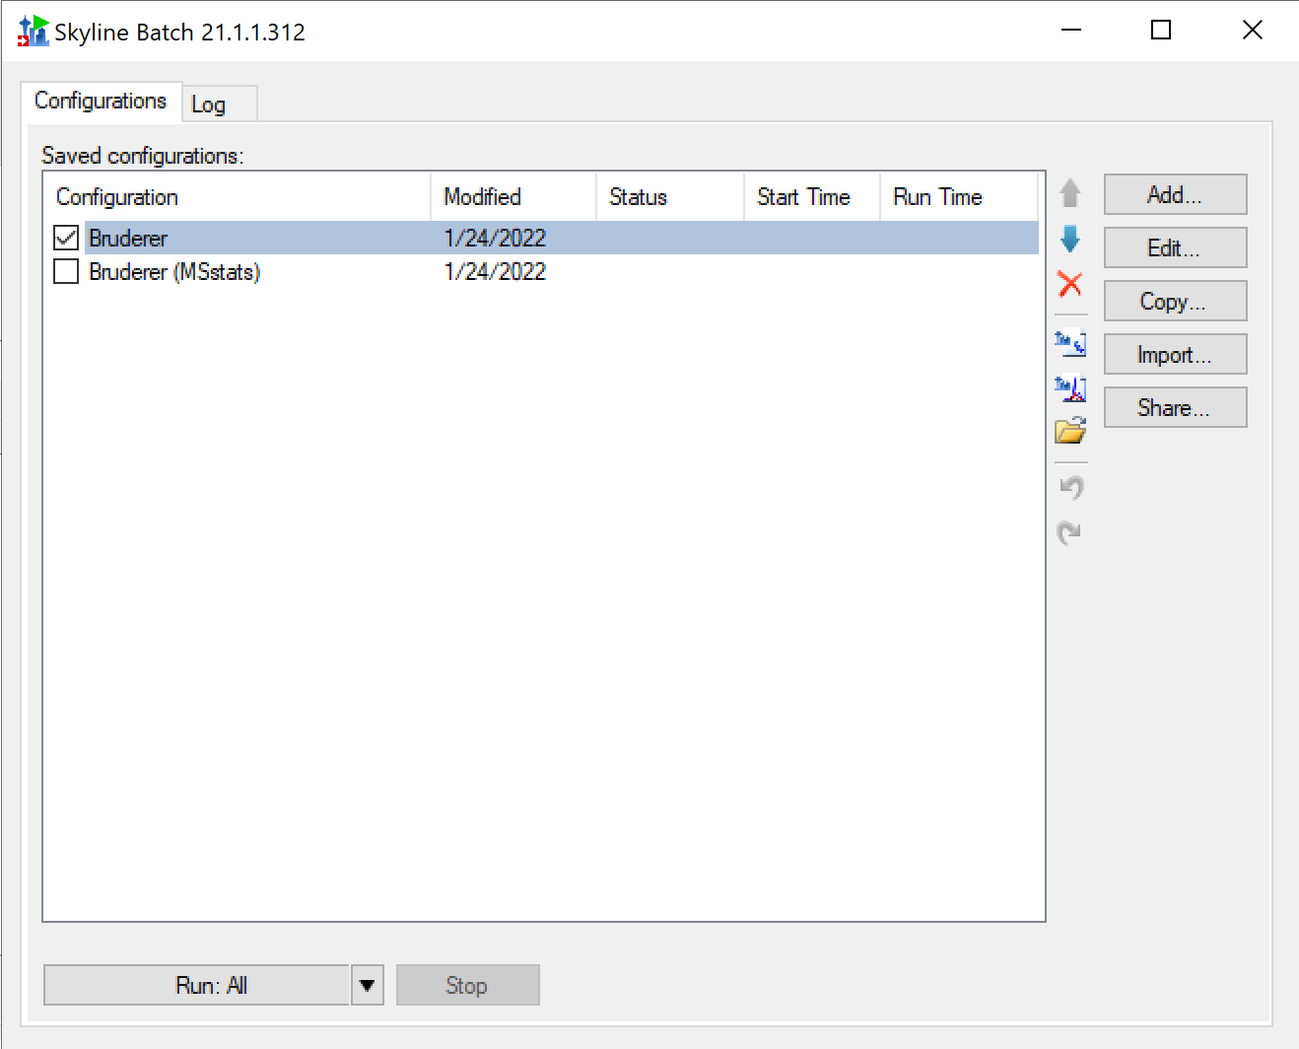
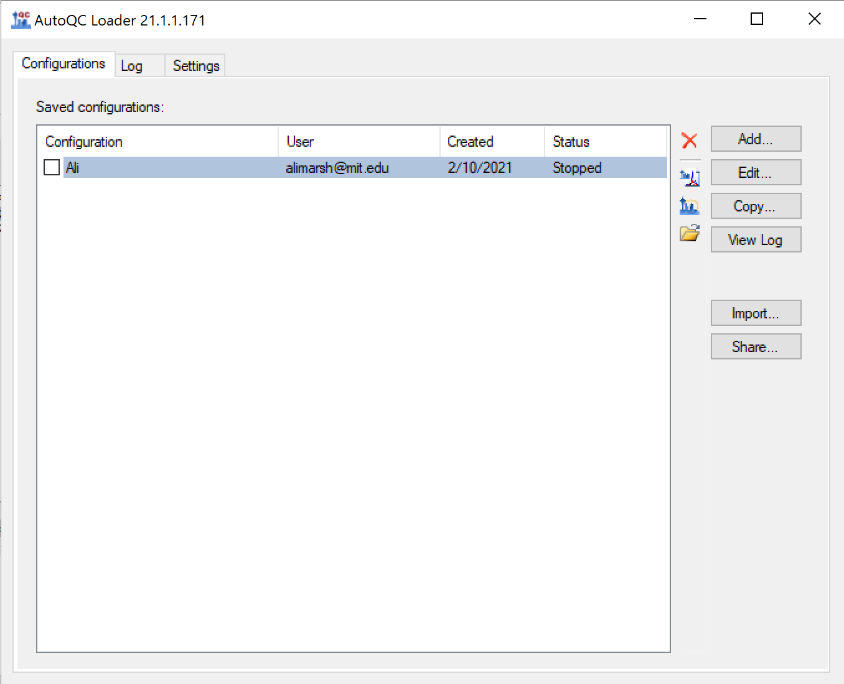
Programs
Skyline Batch
AutoQC

Slide 3
Shared Code
SharedBatch:
Designed as a helpful library of code for any batch application (an application that interfaces to Skyline through batch commands)
SharedBatch should not contain code that is specific to SkylineBatch or AutoQC unless I thought it may also be applicable to another hypothetical Batch application
LaunchBatch:
Tiny project used exclusively to launch a click-once installed batch program by double-clicking a configuration file
Used in FileUtil.cs AddFileTypeClickOnce(…) which is called by the Program.cs in SkylineBatch and AutoQC

Slide 4
SharedBatch
Most specific to batch programs
Least specific
Shared | General forms and controls | Utils
Interfaces.cs | AlertDlg.cs | ChildProcessTracker.cs
ConfigManager.cs | FileOpenedForm.cs | FileUtil.cs
Settings.cs | FilePathControl.cs | LongWaitOperation.cs
Logger.cs | FindSkylineForm.cs | MainFormUtils.cs
SkylineSettings.cs | LongWaitDlg.cs | PanoramaJsonObject.cs
 | ShareConfigsForm.cs | PanoramaUtil.cs
 | SkylineTypeControl.cs | ProcessRunner.cs
 |  | ProgramLog.cs
 |  | SkylineInstallations.cs
 |  | TextUtil.cs
 |  | XMLUtil.cs

Slide 5
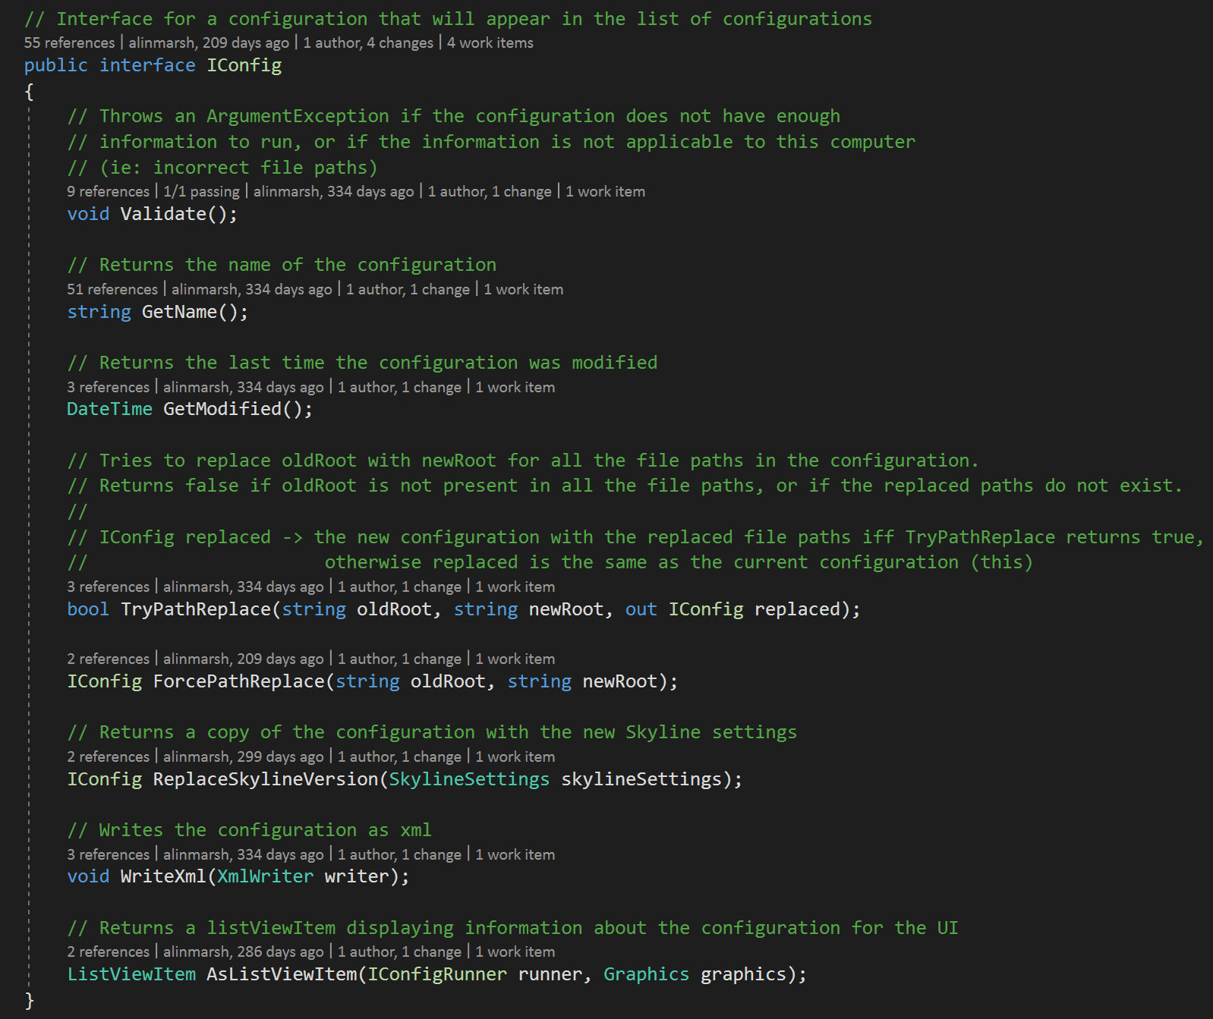
Interfaces.cs
Interfaces and delegates used by both programs
IConfig interface is most important – SkylineBatchConfigs and AutoQcConfigs implement this interface in SkylineBatch and AutoQC

Slide 6
ConfigManager
ConfigManager:
ConfigManagerState _baseState
SkylineBatchConfigManager:
SkylineBatchConfigManagerState _state
AutoQcConfigManager:
AutoQcConfigManagerState _state

Slide 7
SharedBatch ConfigManager.cs
ConfigManager holds the current BaseState of the configuration list, configuration validation, root replacement, and selected configuration
ConfigManager is a relatively small class, with almost no internal methods
ConfigManager has a ConfigManagerState holding all the relevant BaseState information
The BaseState is obtained and set using GetState and SetState methods
SetState takes the expected current BaseState and the new BaseState. It makes sure the current BaseState = the expected BaseState and that the new BaseState is valid before switching (ie: in the middle of removing the last configuration we have removed the config but not changed the selected index to be in bounds of the list. This would be an invalid configuration)
ConfigManagerState has all the methods to create, manipulate, and validate a BaseState. Methods that change it always return a ConfigManagerState so they can be chained.
PseudoCode for adding a configuration:
AddConfig(ConfigManager configManager) {
var currentState = configManager.GetState();
var newState = currentState.Copy();
… add config to new state …
configManager.SetState(currentState, newState);
}

Slide 8
ConfigManagerState
ConfigManagerState:
ImmutableList<IConfig> ConfigList
int Selected
ImmutableDictionary<string, bool> ConfigValidation
ImmutableDictionary<string, string> RootReplacement
SkylineBatchConfigManagerState:
readonly ConfigManagerState BaseState
ImmutableDictionary<string, string> Templates
ImmutableDictionary<string, IConfigRunner> ConfigRunners
ImmutableDictionary<string, RemoteFileSource> FileSources
AutoQcConfigManagerState:
readonly ConfigManagerState BaseState
ImmutableDictionary<string, IConfigRunner> ConfigRunners
ImmutableList<Logger> LogList
int SortedColumn

Slide 9
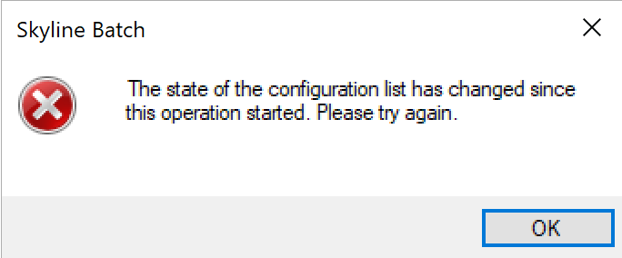
Extensions of ConfigManager.cs
AutoQC and SkylineBatch need more tailored versions of ConfigManager: SkylineBatchConfigManager.cs and AutoQcConfigManager.cs
SkylineBatchConfigManager.cs uses the BaseState of ConfigManager to hold the configuration list, validation, etc, but the SkylineBatchConfigManagerState also has templates, config runners, and filesources (things that AutoQC doesn’t need)
Things to note:
All State types (ConfigManagerState, SkylineBatchConfigManagerState, AutoQcConfigManagerState) are not immutable, but publicly accessed variables are immutable. All changes to State types happen internally (ie: call AddConfig instead of adding a config to the list yourself)
State types should not be manipulated after they have been assigned as the current state – they need to be copied!
In Skyline Batch, Undo/Redo is implemented by keeping a list of the previous States in the SkylineBatchConfigManager
Error if the expected current state is not the actual current state when SetState is called. This should never happen when user is running program, but this error will appear if a functional test is run in the wrong order (ex: a button is pushed on a parent form while child is open, impossible for user to do but possible for test)

Slide 10
Tests (please run asap – I added more)
Skyline Batch
Has unit tests and functional tests (functional tests use copied version of AbstractFunctionalTest from Skyline)
To run:
Build Skyline on the branch you will test on
Install R-4.0.3 at C:\Program Files\R
(found here, click “R-4.0.3-win.exe”, install with defaults)
There is one test that shows an error in the log (red text), this is on purpose. It will still pass.
AutoQC
Unit tests only. Functional tests can be added in same form as SkylineBatch.
The TestPublishToPanorama test uses a file that was too big to commit to GitHub. To pass this test:
Go to Start Page: /00Developer/Ali (panoramaweb.org) and download QEP_2015_0424_RJ_05_prtc.raw
Go to the pwiz_tools\Skyline\Executables\AutoQC\AutoQCTest\Test folder and create a “PanoramaTestConfig” folder
Move the downloaded QEP_2015_0424_RJ_05_prtc.raw file to PanoramaTestConfig
SharedBatch
No tests specifically for SharedBatch. SharedBatch functionality is tested in Skyline Batch tests
SharedBatchTest holds helpful code for AutoQc and SkylineBatch tests

Slide 11
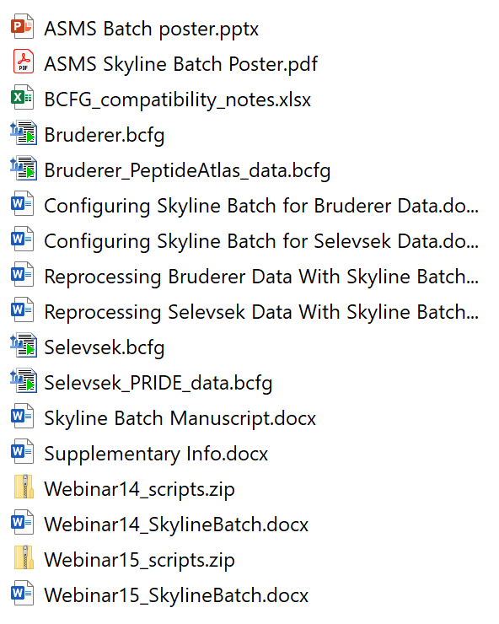
Files
pwiz_tools\Skyline\Executables\SkylineBatch\Documents:
Current versions of Skyline Batch Tutorials, ASMS poster, paper:
pwiz_tools\Skyline\Executables\SkylineBatch\Documents
Skyline Batch Documentation:
pwiz_tools\Skyline\Documentation

Slide 12
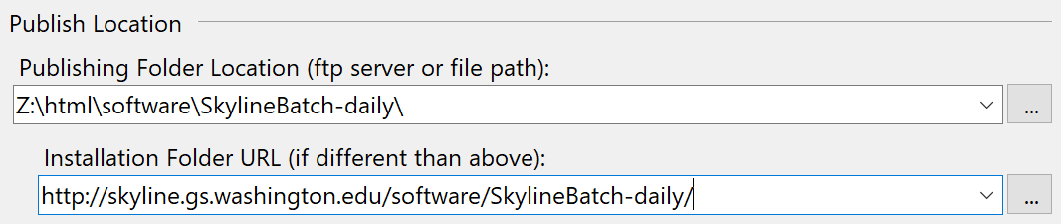
Releasing Skyline Batch
Very similar to AutoQC:
Change release version
Update publishing location based on if release/daily
Update documentation if needed
Go to Z:\html\software\SkylineBatch (Z mapped to \\skyline\data\www\site)
Rename SkylineBatchDocumentation.pdf using last release version
Add current documentation as SkylineBatchDocumentation.pdf (the Skyline Batch page links to this file)
Note:
If the bcfg version has been changed make sure the xml tests pass and take a look at BCFG_compatibility_notes.xlsx in documents

Slide 13
Projects

Slide 14
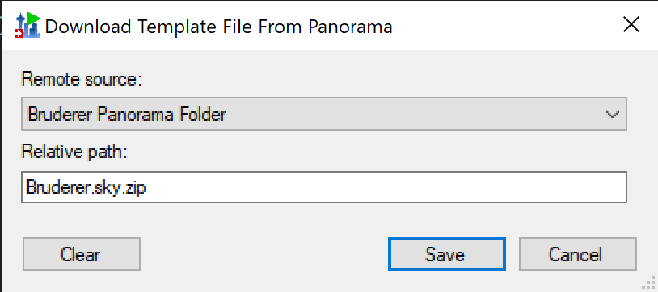

File Tree UI for Relative Path
RemoteFileForm.cs
RemoteFileControl.cs
New button to open file tree
Pseudocode:
Get selected remote source with RemoteFileSourceFromUI()
Use URI, username, and password fields from remote source for inputs to new file selector form
Set textRelativePath.Text when file is selected
Things to consider:
Remote sources for data files can also be from FTP servers. May want to disable button if fileSource.FtpSource is true.

Slide 15
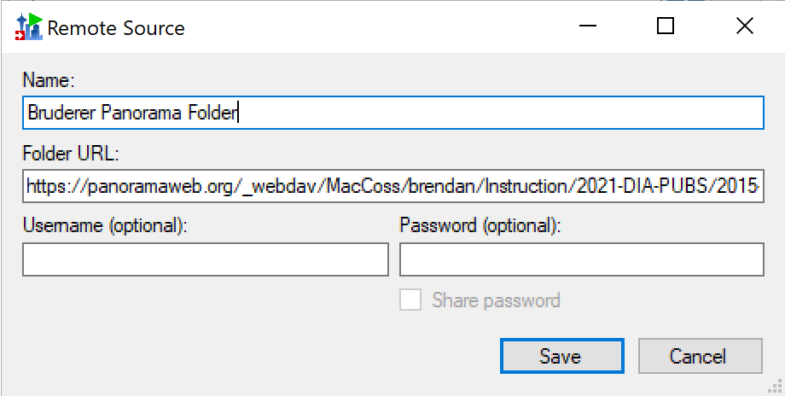
Panorama File Tree for Remote Source - Added
RemoteSourceForm.cs
Potential new button to open Panorama
Pseudocode:
Use new Panorama file tree form to select panorama folder (or file, but remote sources are more useful if they are folders and the relative paths can be used to select the file)
Set testFolderUrl.Text to selected path

Slide 16
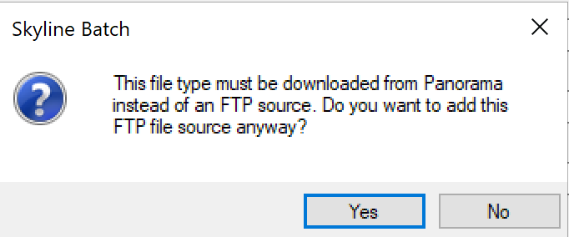
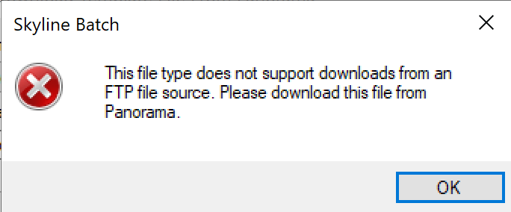
Download All Files From FTP
Downloading Files:
Skyline template file: Panorama only
Annotations file: Panorama only
R script: Panorama only
Data files: Panorama or FTP
Report files: No download available
Currently SkylineBatch only supports downloading data files from FTP servers, other files must be downloaded through Panorama.
If you try to add an FTP remote file source for another type of file you get Message 1
If you try to select an FTP source for an unsupported file you get Message 2
Getting started:
Two parts – 1) connecting to the server to find the file names and sizes when a: the configuration is created and b: when run is started 2) downloading the files when config is run
ServerConnector and PanoramaServerConnector are used to connect to the servers in part 1
DownloadPanoramaFIle(…) and DownloadData(…) are used to download files in ConfigRunner.cs when config is run (part 2)
When parts 1 and 2 support FTP for all files, the error messages and preferPanorama variables can be removed.
Message 1
Message 2

Slide 17
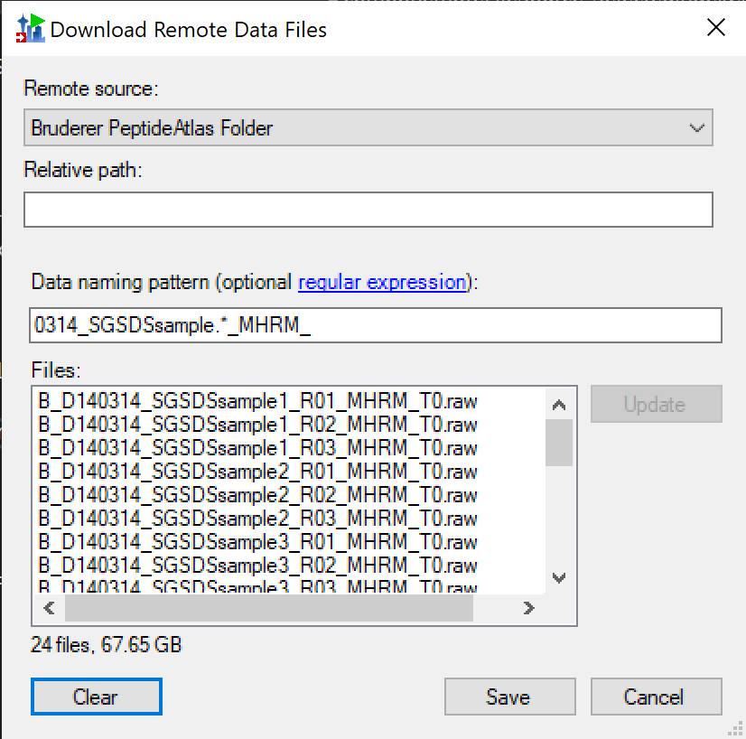
Select Data Files From List
This was requested by a user
Instead of typing in a Data naming pattern that updates the list they wanted a way to select the data files one at a time by name
The least invasive way to do this would be to generate a naming pattern from the selected files when save is clicked

Slide 18
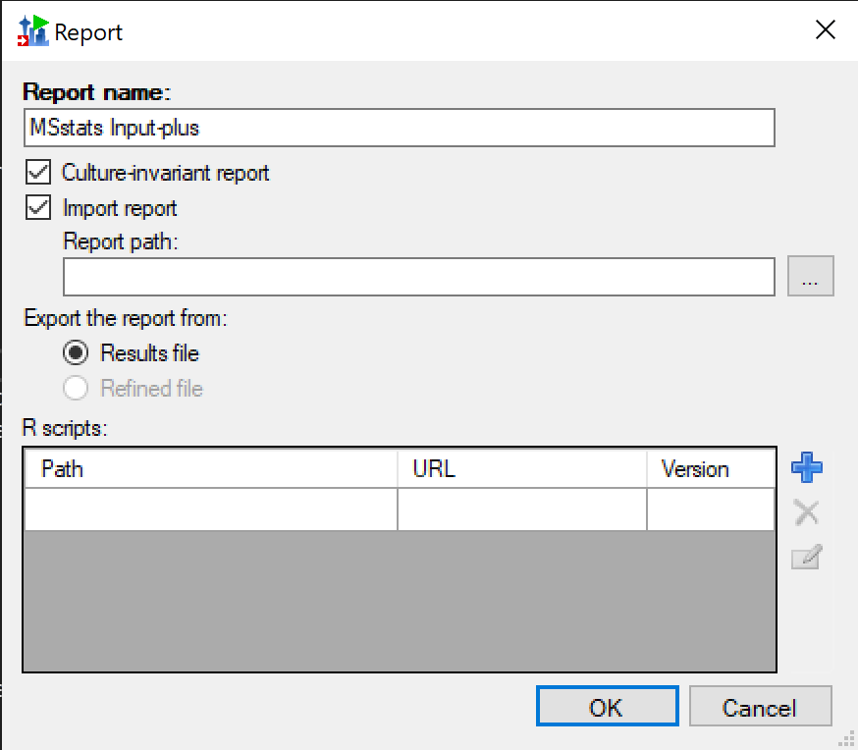
Download skyr File
This is the only file I don’t have a download option for
Reports can be added to template files – so this isn’t 100% necessary but may be helpful if someone doesn’t know they can do this
PseudoCode:
Replace the report path textbox and file explorer button with a DownloadingFIleControl
Add to Run(…) in ConfigRunner.cs to check if the report needs to be downloaded and download it using DownloadPanoramaFile(…) if it does
Edit the AddDownloadingFiles(…) method in ReportSettings.cs to add the server for the skyr file if it will be downloaded – this will check the server when you start running the configuration
ReportsAddForm.cs
Replace this with a DownloadingFileControl – lots of examples in SkylineBatchConfigForm.cs

